Slide 1
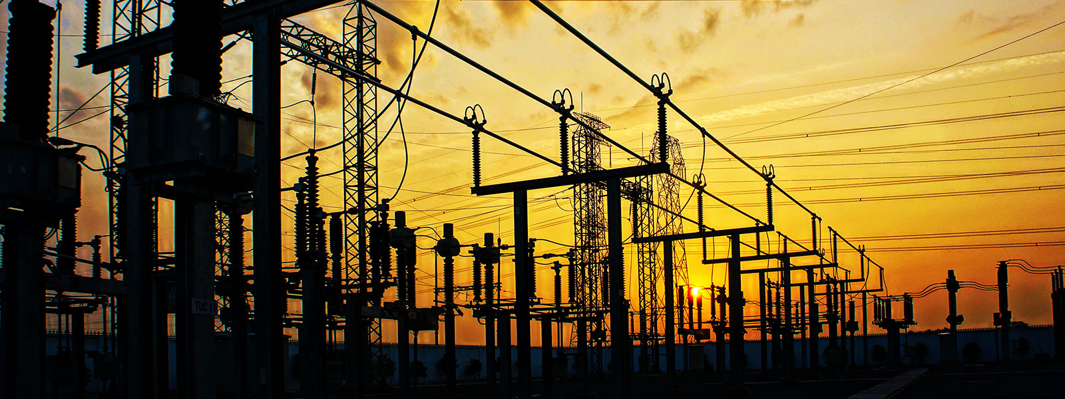
Distributed Generation system

Slide 2
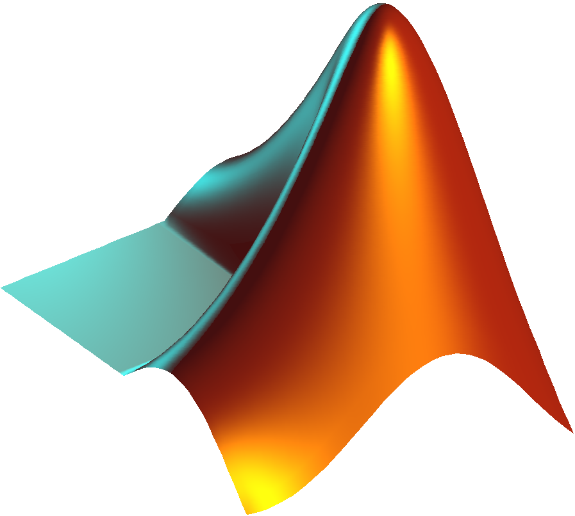
Outline:
What is Distributed Generation?
Advantages of DG
Block Diagram of DG
Synchronous Generator
Permanent Magnet Synchronous Machines
Assumptions and Calculations
Outputs
3-ф DC-AC Inverter
Specifications
Pulse Width Modulation
Low Pass Filter

Slide 3
What is Distributed Generation ??
An active small scale generation at distribution level.
Generation of electricity by facilities sufficiently smaller than central plants, so as to allow interconnection at nearly any point in the power system , as Distributed Resource.
Yield power in capacities that range from a fraction of a kilowatt [kW] to about 100 megawatts [MW].
Often include renewable energy technologies that are site specific, such as wind turbines, geothermal energy production, solar systems (photovoltaic and combustion), and some hydro-thermal plants.

Slide 4
Advantages of DG
It reduces the power losses while transmission as they are very near to the load.
Increased electric system reliability
Emergency supply of power
Reduction of peak power requirements
Provision of ancillary services like regulation, reactive power and black start etc.,

Slide 5
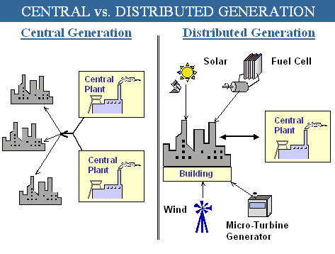
DG
CG

Slide 6
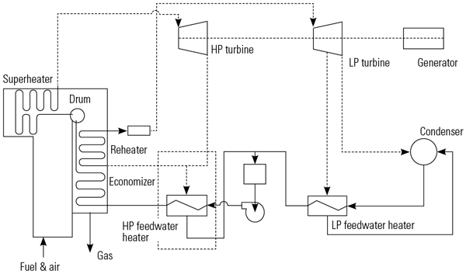
Synchronous Generator
Synchronous refers to the fact that the rotor and magnetic field rotate with the same speed.
Ideal for power generation: Uniform, controllable waveform output
A permanent magnet synchronous Machine (PMSM) has a fixed excitation provided by a permanent magnet instead of coil.
The prime mover of this generator (In our case) is the combination of LP and HP Turbines at thermal power station.

Slide 7
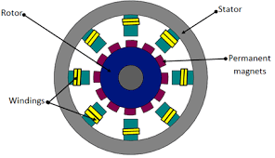
Why a PMSM ??
Simplicity in design
No system is required for Excitation.
Minimum Energy Dissipation
As per our goal to reduce environmental damage, this machine helps a lot.

Slide 8
Assumptions and Calculations
It is assumed that the generator is in steady state condition.
We obtain Quadrature current using the torque.
For the 1st iteration, the Direct and Quadrature currents are assumed to be 0.
Again for the 1st iteration, Quadrature and Direct voltage will be calculated using only the speed voltages..
Now using inverse park, we get phase voltages and currents.

Slide 9
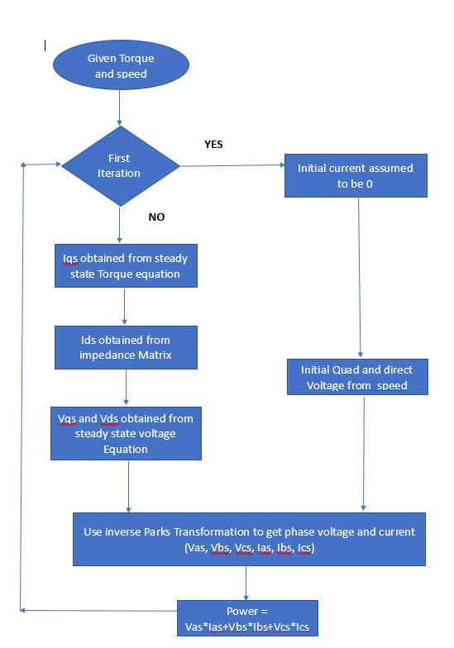
Flow Diagram

Slide 10
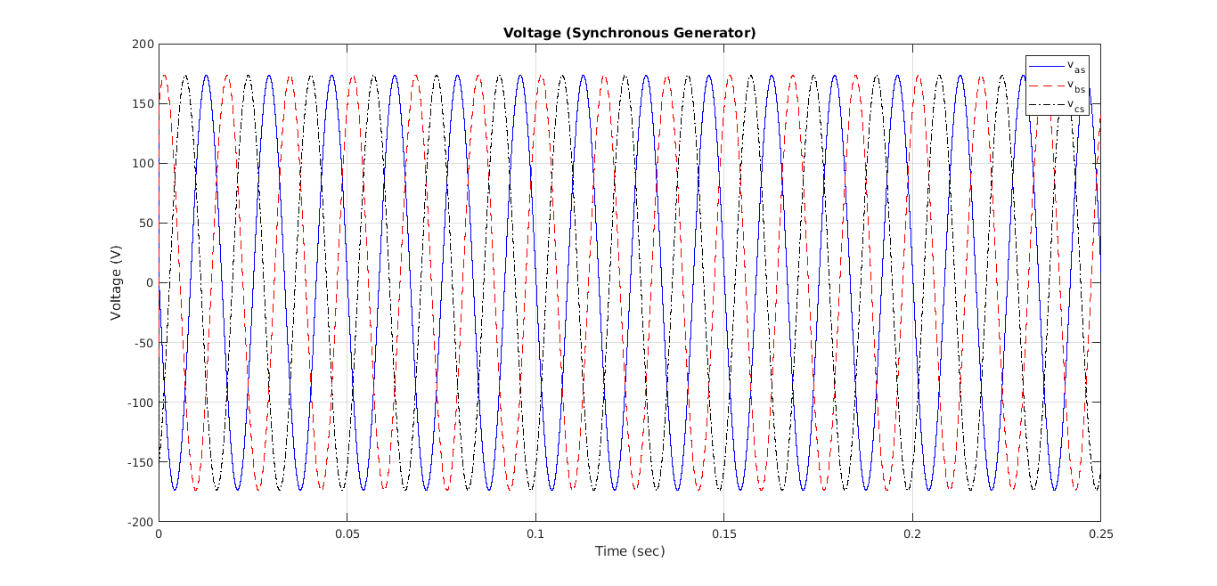
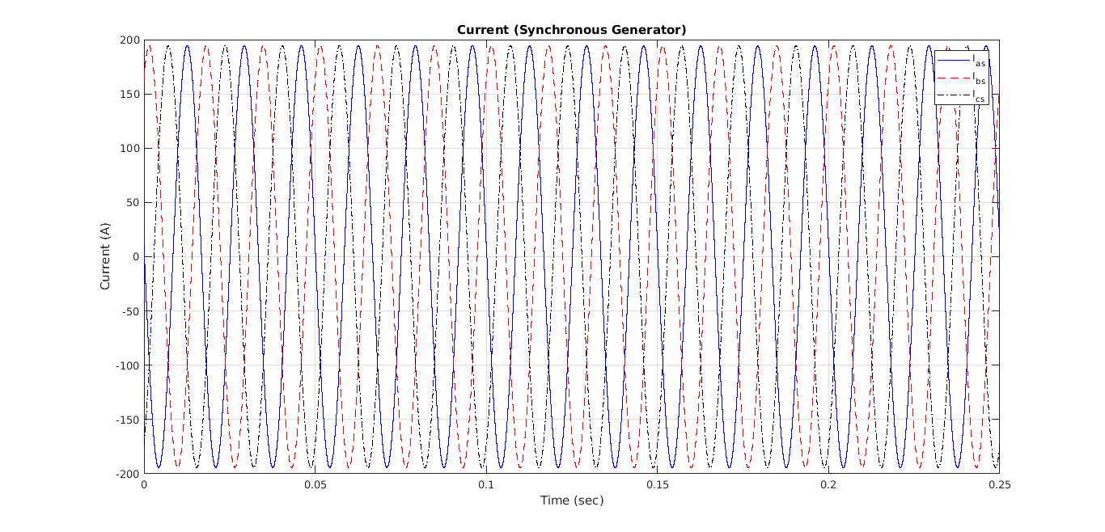

Slide 11
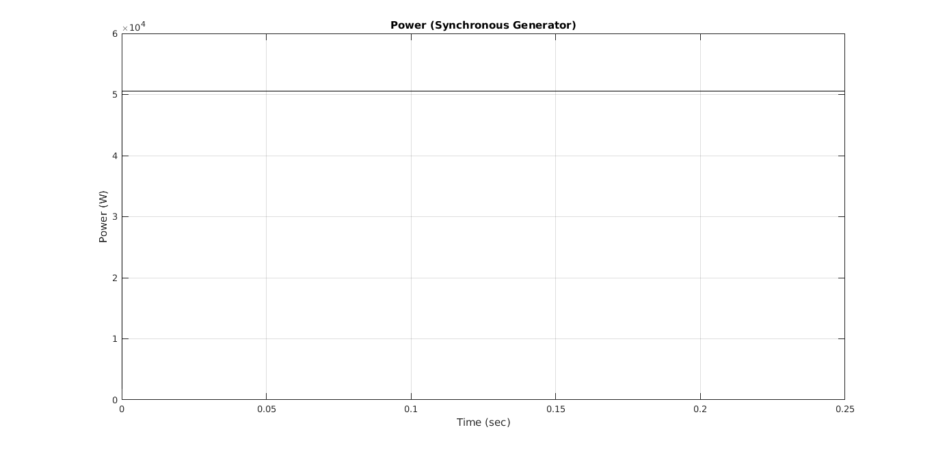

Slide 12
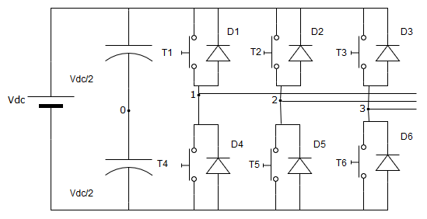
3-ф DC-AC Inverter

Slide 13
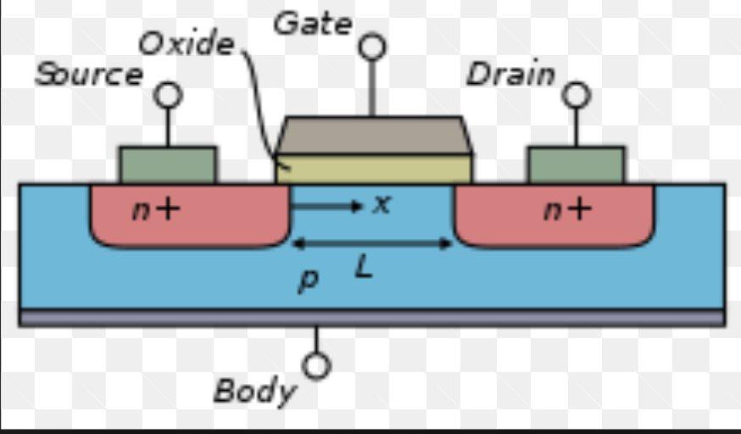
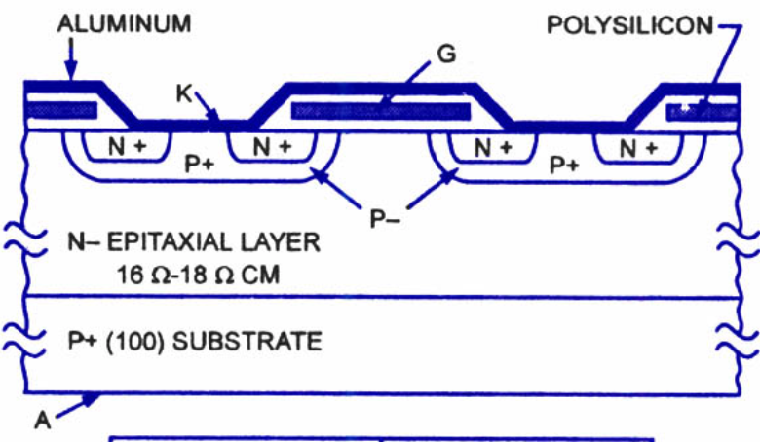
MOSFET vs IGBT

Slide 14
MOSFET vs IGBT
Two of most important modern devices
IGBTs excellent for high power, low frequency devices: Some of the advantages of FET and BJT combined into one device
MOSFETs find most frequent “general use”: Excellent for high frequency operation, and consume very little power. Any low or medium power system should use FET

Slide 15
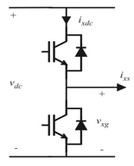
Specifications
Ideal MOSFETS with anti parallel DIODES are employed to switch DC Source
3 legs with two complimentary switches per leg
Operated in Saturated / Off regions
No Delays
No Leakage or Inrush current
Operational Amplifiers are used to generate PWM for switches
Sinusoidal Input with a fundamental frequency of 60Hz
Saw tooth waveform for control of PWM
Three stages with 120˚ phase shift

Slide 16
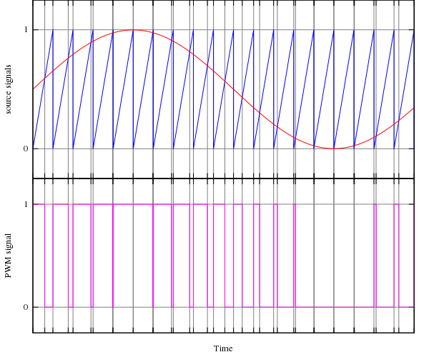
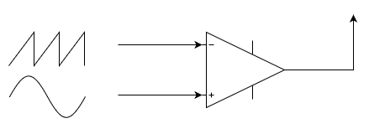
Pulse Width Modulation (PWM):

Slide 17
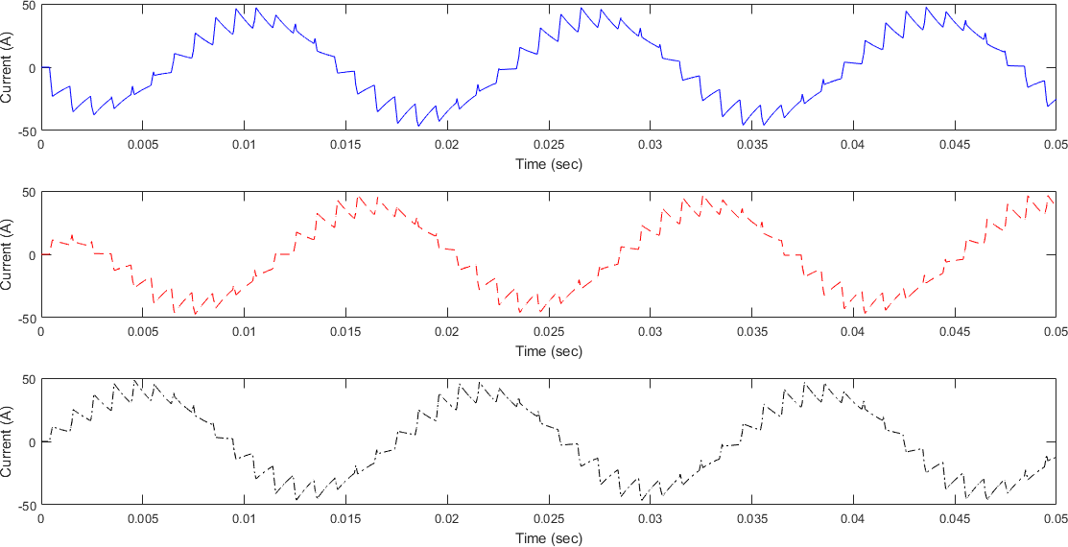

Slide 18
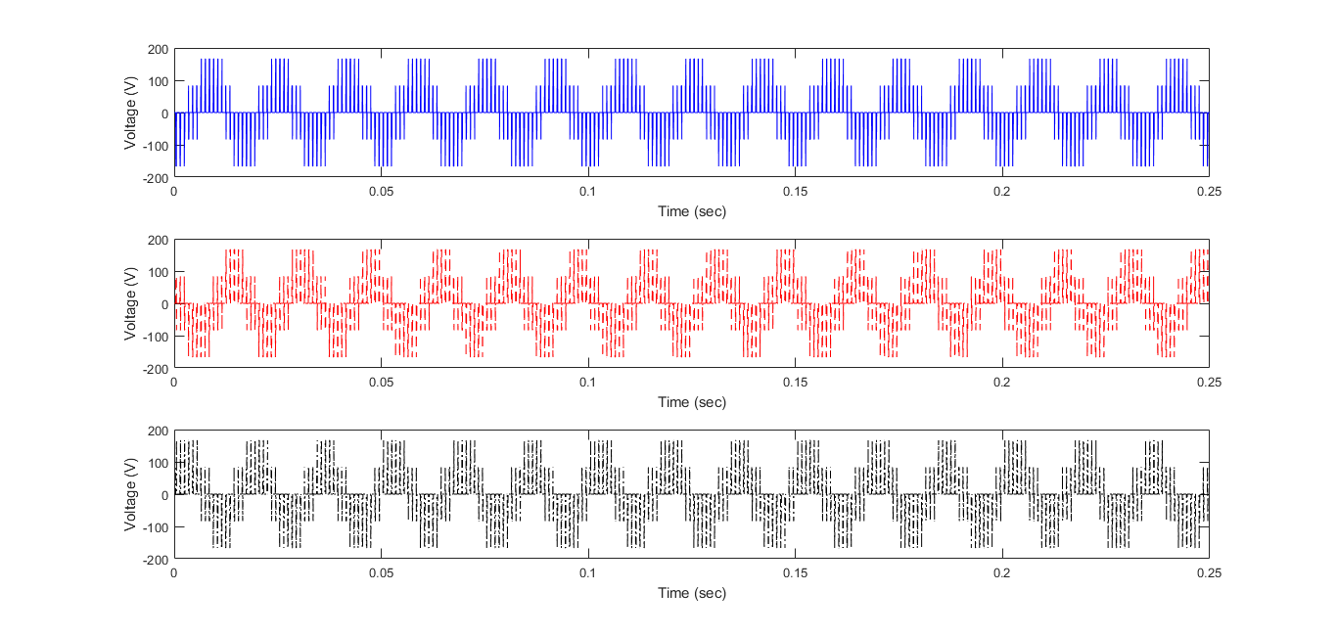
HIGH FREQUENCY COMPONENTS !!
HIGH FREQUENCY COMPONENTS !!

Slide 19
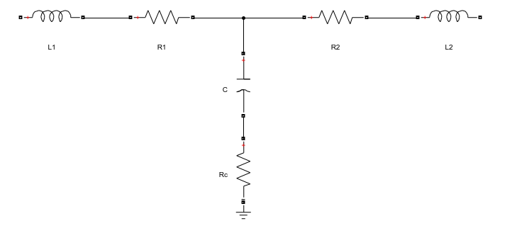

Low Pass Filter
To eliminate HIGH FREQUENCY COMPONENTS from the output of converter.
Out of all the available topologies, LCL has been chosen to eliminate 3rd order harmonics and to deliver more stable outputs.

Slide 20
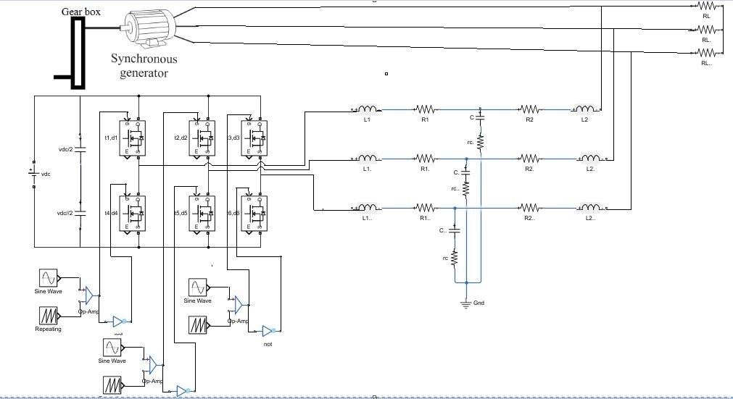
Inverter with LPF

Slide 21
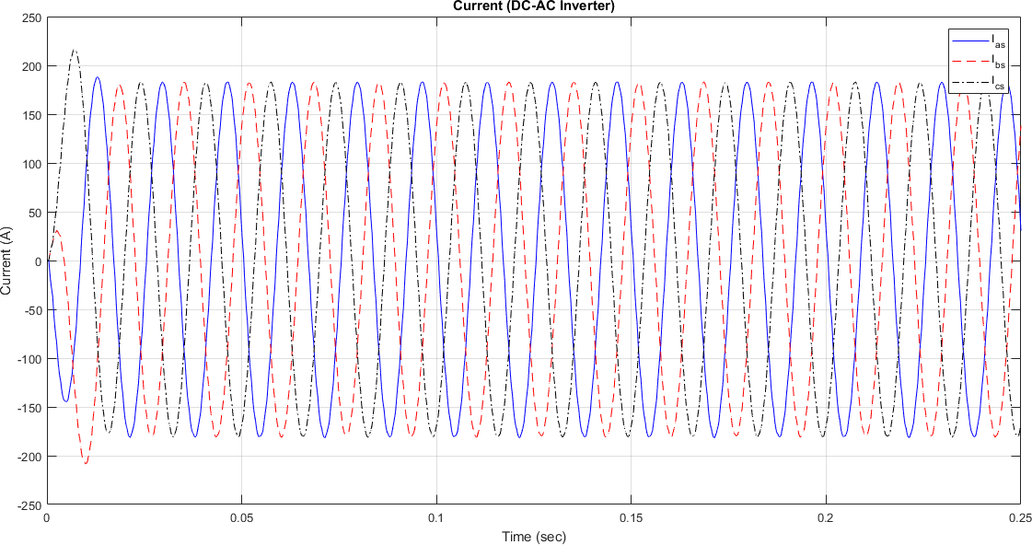

Slide 22


Slide 23
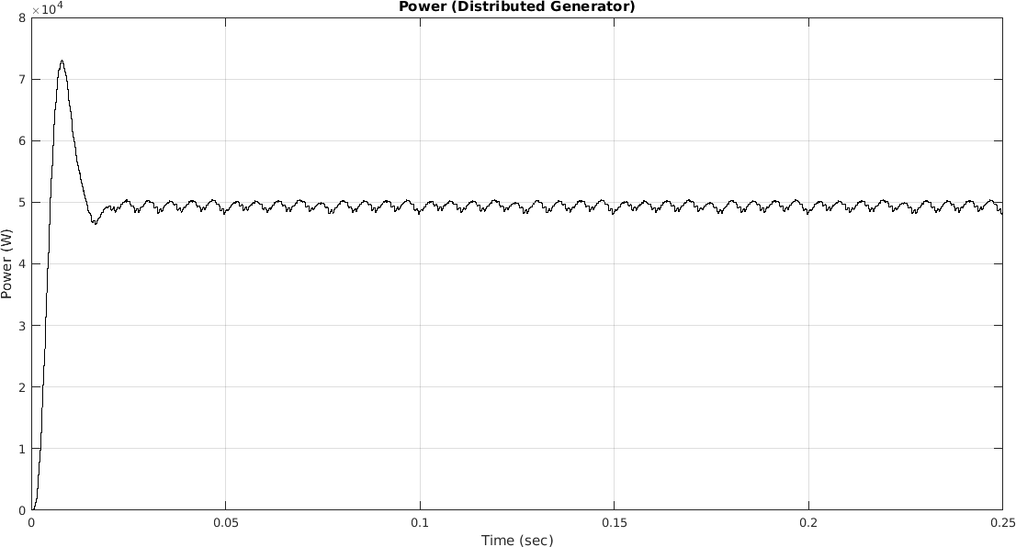

Slide 24

Supporting GRID
Before connecting our secondary generator to the grid, following parameters have to match :
Phase Sequence
Voltage Magnitude
Frequency
Phase Angle

Slide 26
DG Model

Slide 27
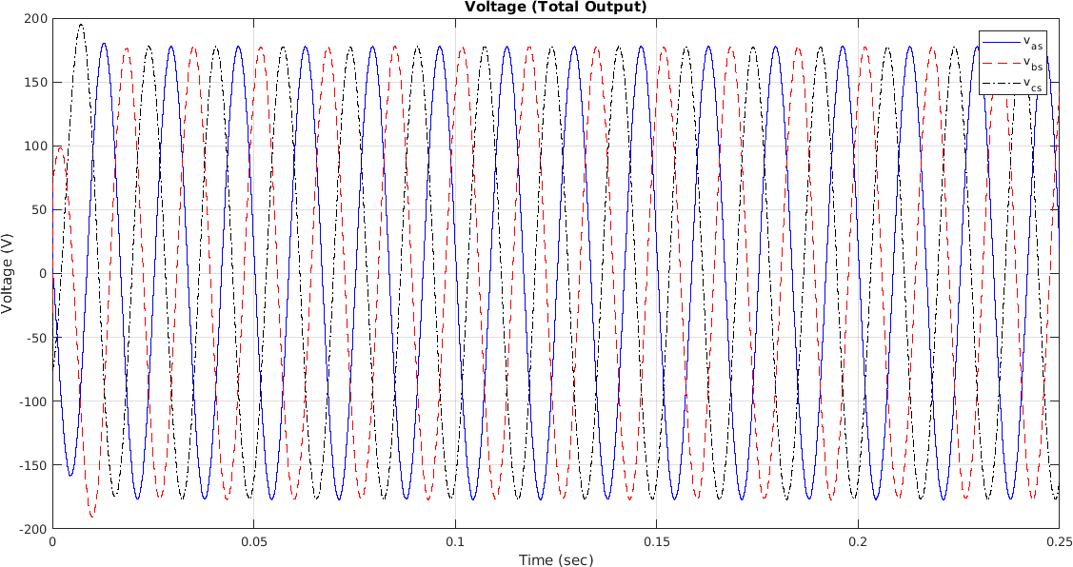

Slide 28
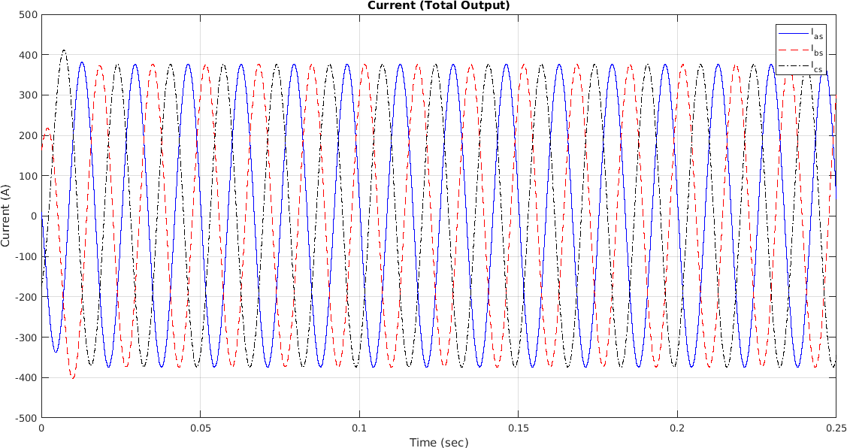

Slide 29
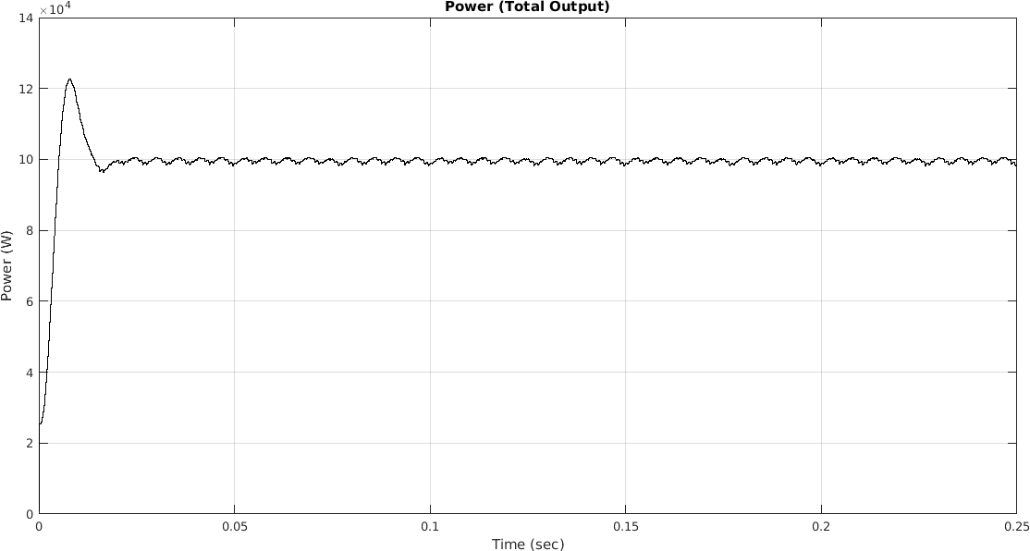

Slide 30
Conclusion
Reduced Load by 50% on Thermal Power Stations to lessen environmental Damage.
Another 50% of the load is supplied using DC-AC inverter locally.
High frequency components from the inverter are eliminated using LPF.
All the required steps are taken before connecting the local generator to the grid.

Slide 31

THANK YOU !!

Slide 32


